Slide 1
Alpha Moonbase
Artistic Engeneering

Slide 2
About Me
Wieland Hilker aka Jonas Schmitt
Currently student of Architecture @ UDK Berlin
Completed education as Event Technician
Video Technician @ Deutsche Oper Berlin
Freelance Light and Videodesigner

Slide 3
TouchDesigner Projects
Lajka – ArtNET Controlled Mediaserver for Theatre
Belka – Touchscreen optimized interface for LiveVJing
Posh – Voting and Mediaplaybacksystem for „Reset:Earth“ @ Theater Erlangen
„Dive In“ – Interactive Kinectinstallation @ Stadt für eine Nacht Festival

Slide 4
Lajka
Born from the neccesity of a cheap Mediaserver
Non Profit Theatre
Integrated into lighting Workflow -> ArtNET
Later installed @Staatstheater Braunschweig Haus 3
Need for easy to use interface

Slide 5
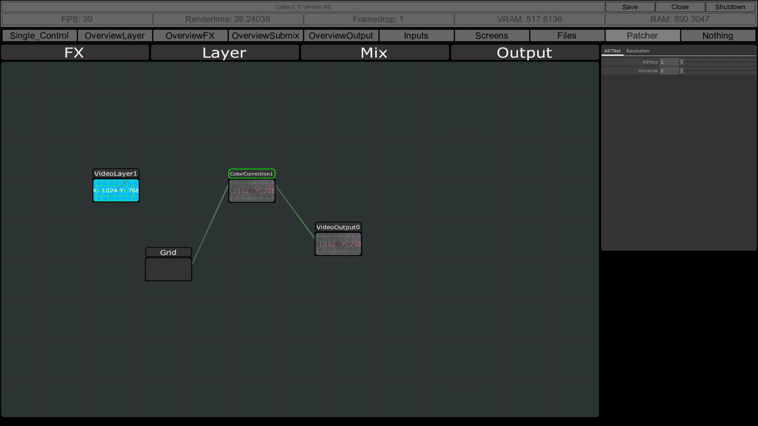

Slide 6
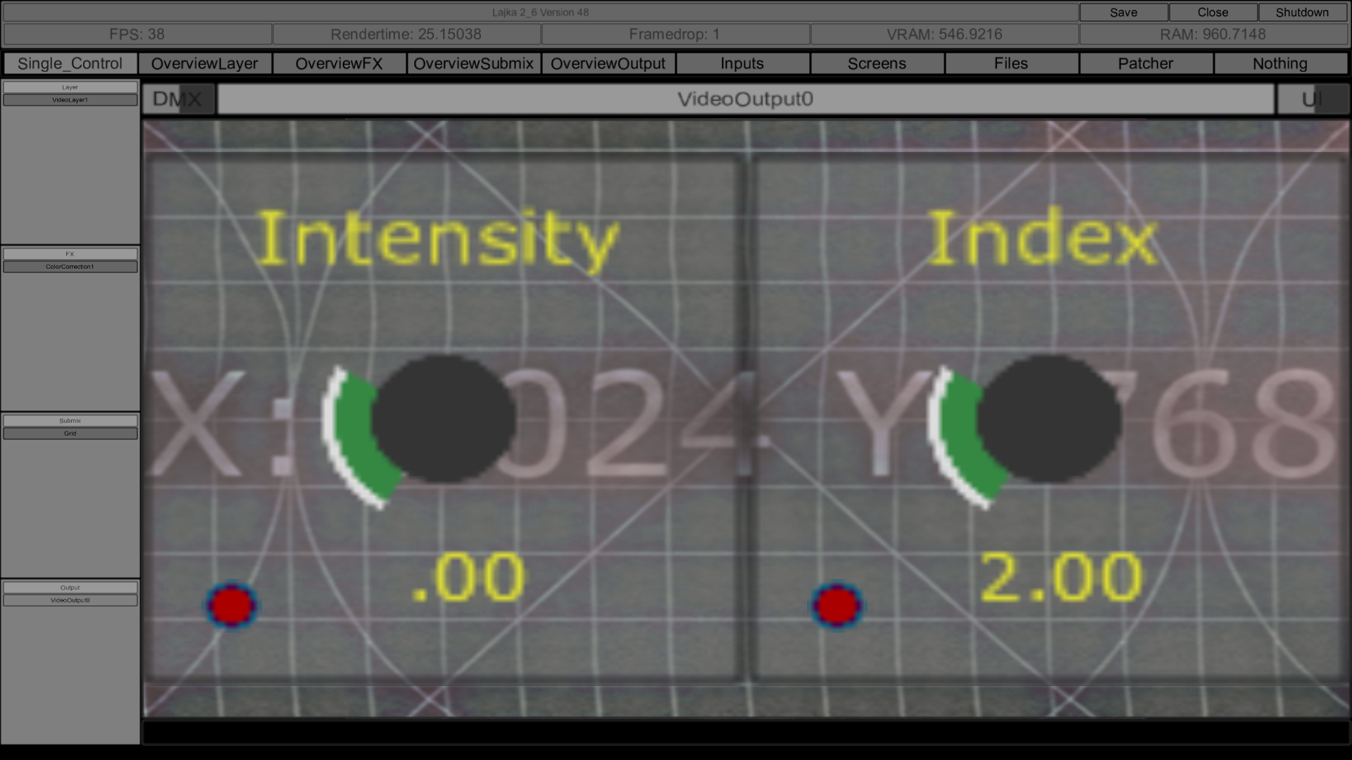

Slide 7
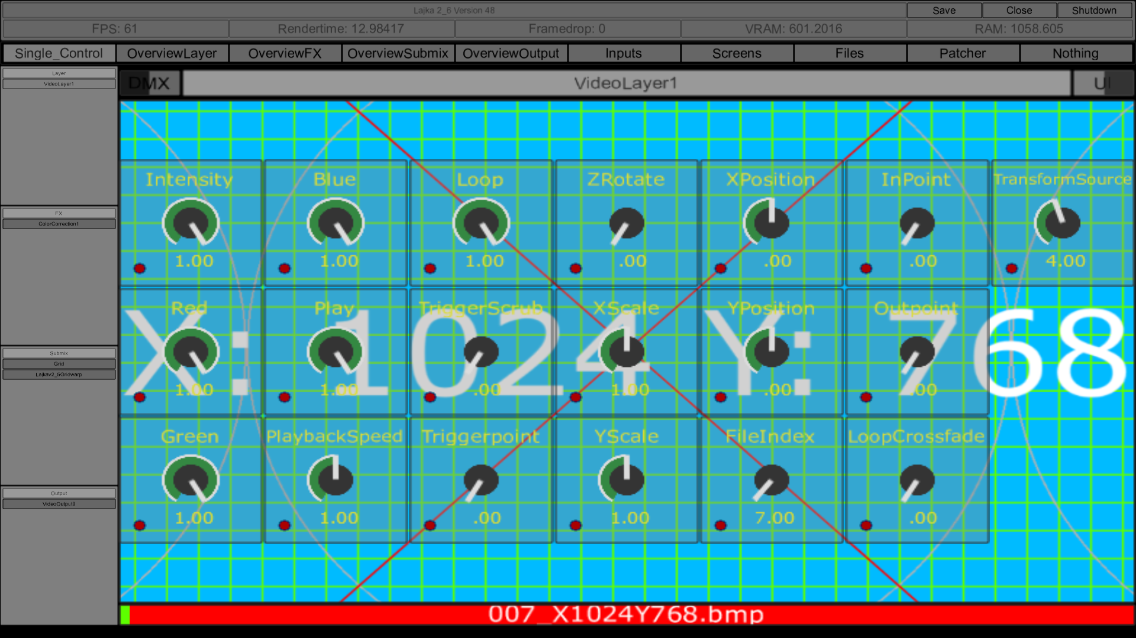

Slide 8
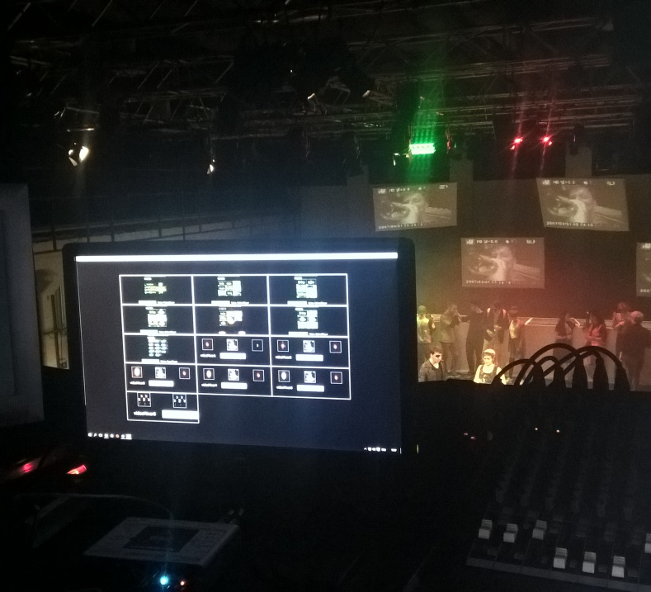
UDysse

Slide 9
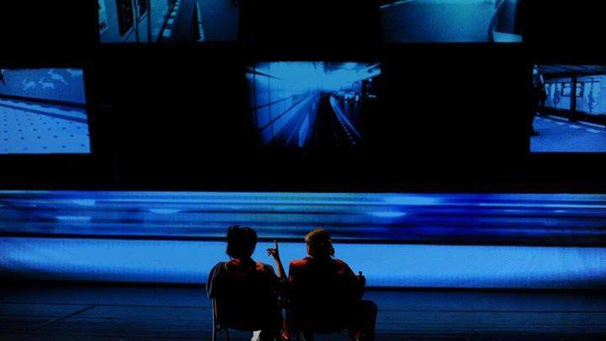

Slide 10
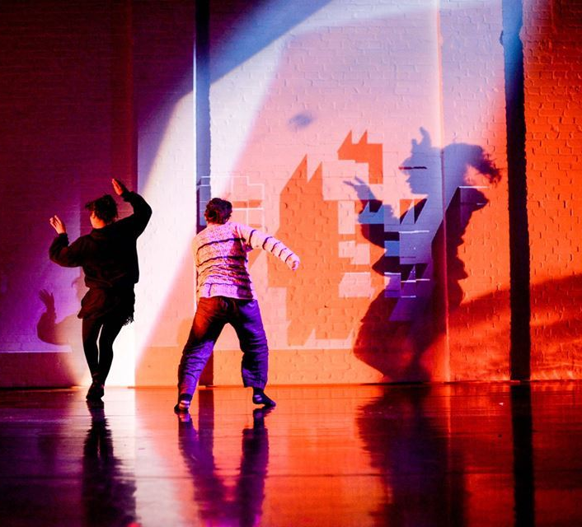
Foreign Bodies
International Danceproject
Integration of live generated content using a Kinect

Slide 11
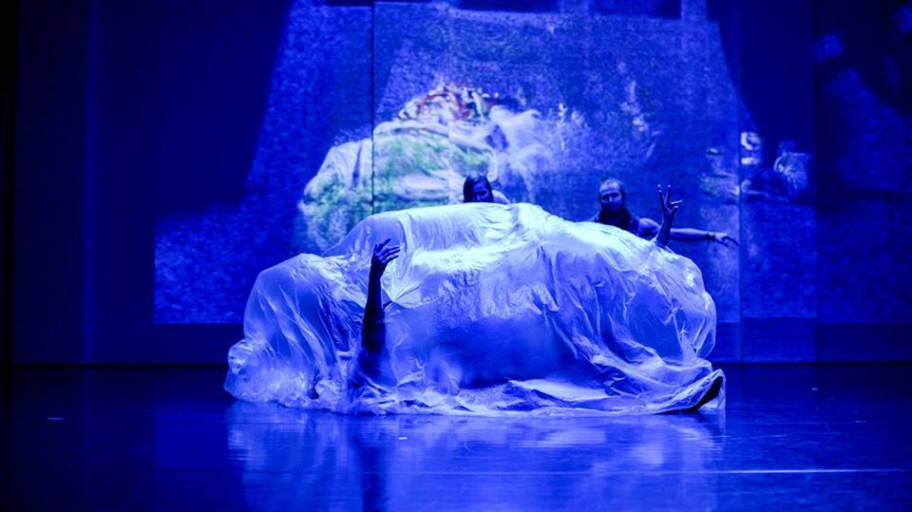

Slide 12
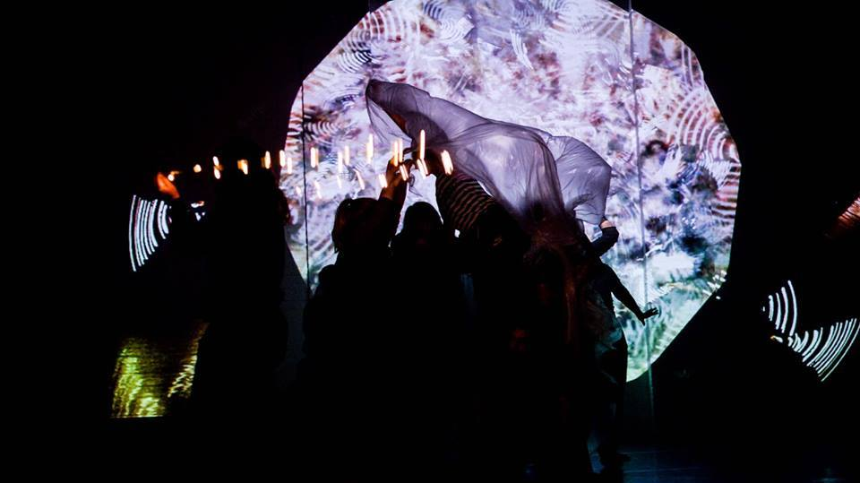

Slide 13
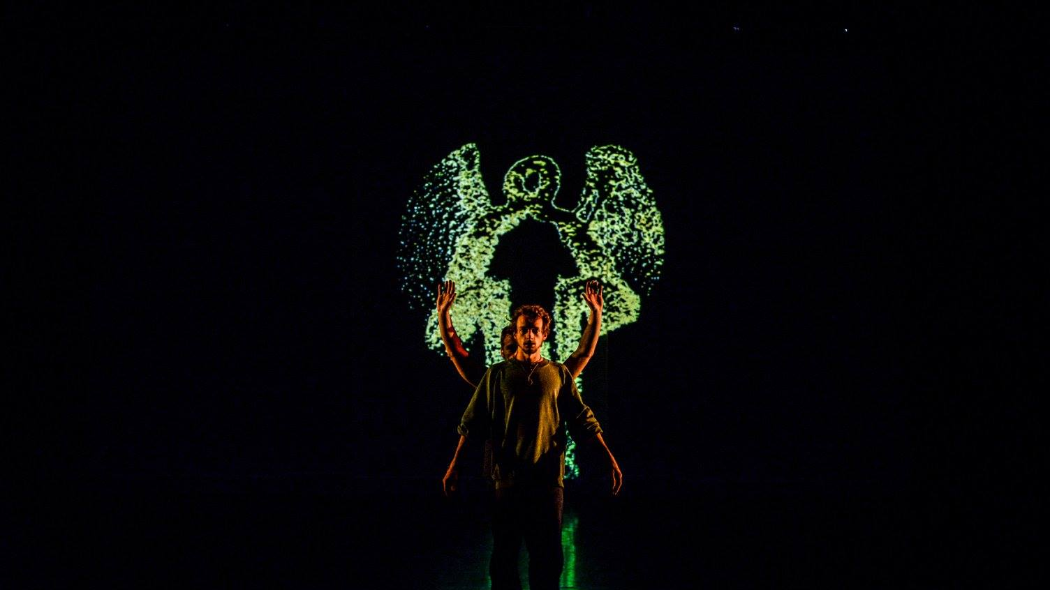

Slide 14
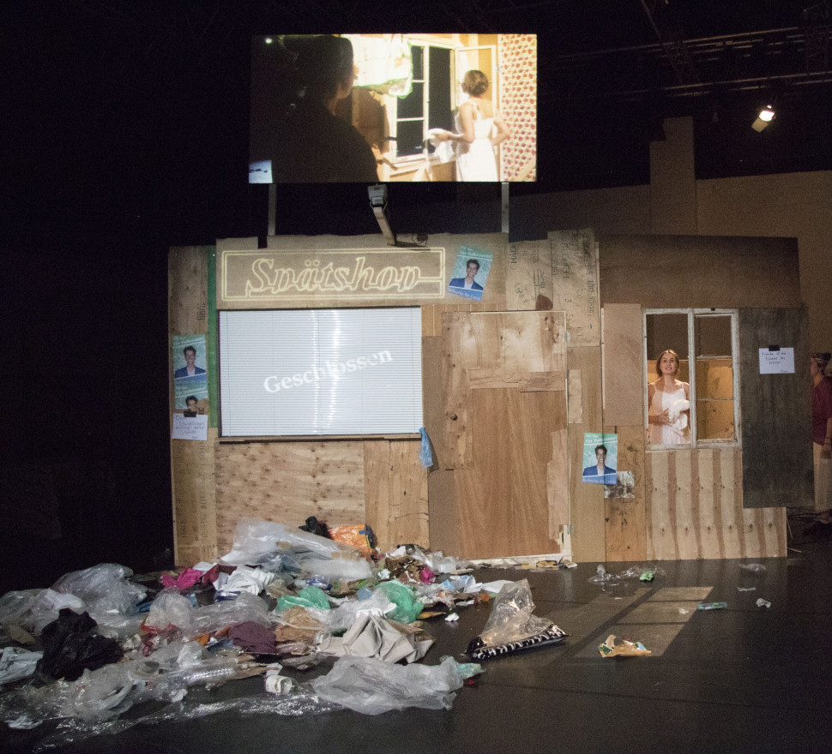
Stadt ohne Ufer
3 Projectors
Livevideo via Handheld camera

Slide 15
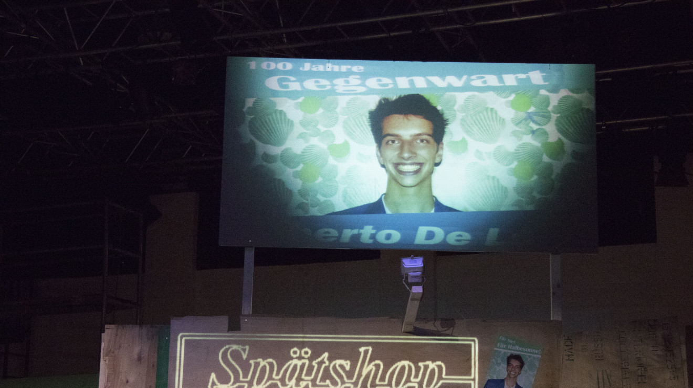

Slide 16
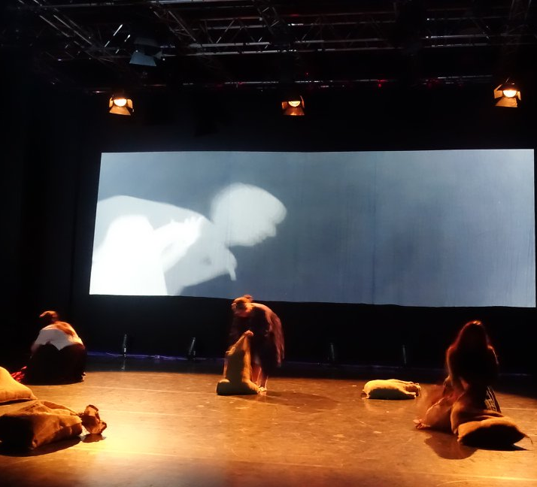
Golem
3 Projectors
Edgeblending
Mapping on small objects
Controlling video and light from the same source

Slide 17
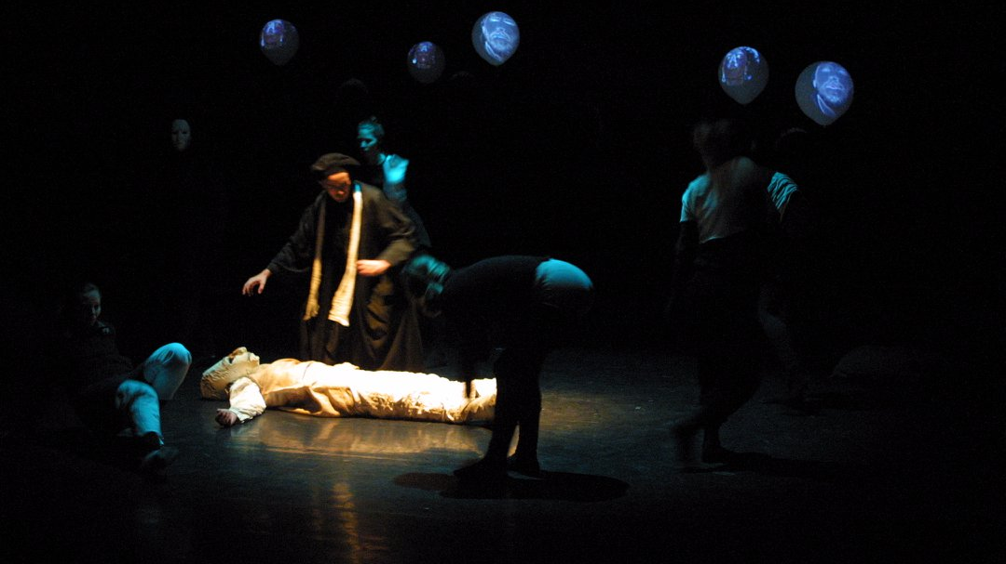

Slide 18
Belka
I already paid for TouchDesigner
Why pay for Resolume
Never used resolume
Works like I think resolume works
I don‘t want to carry arround a controller, so made for touchscreen

Slide 19
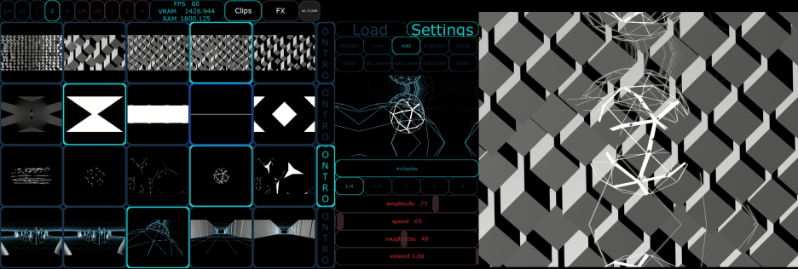

Slide 20
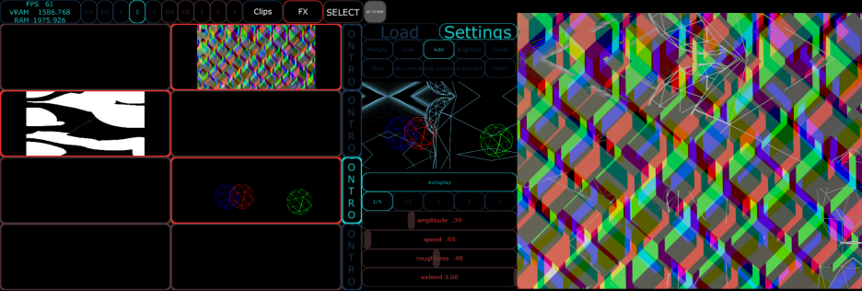

Slide 21
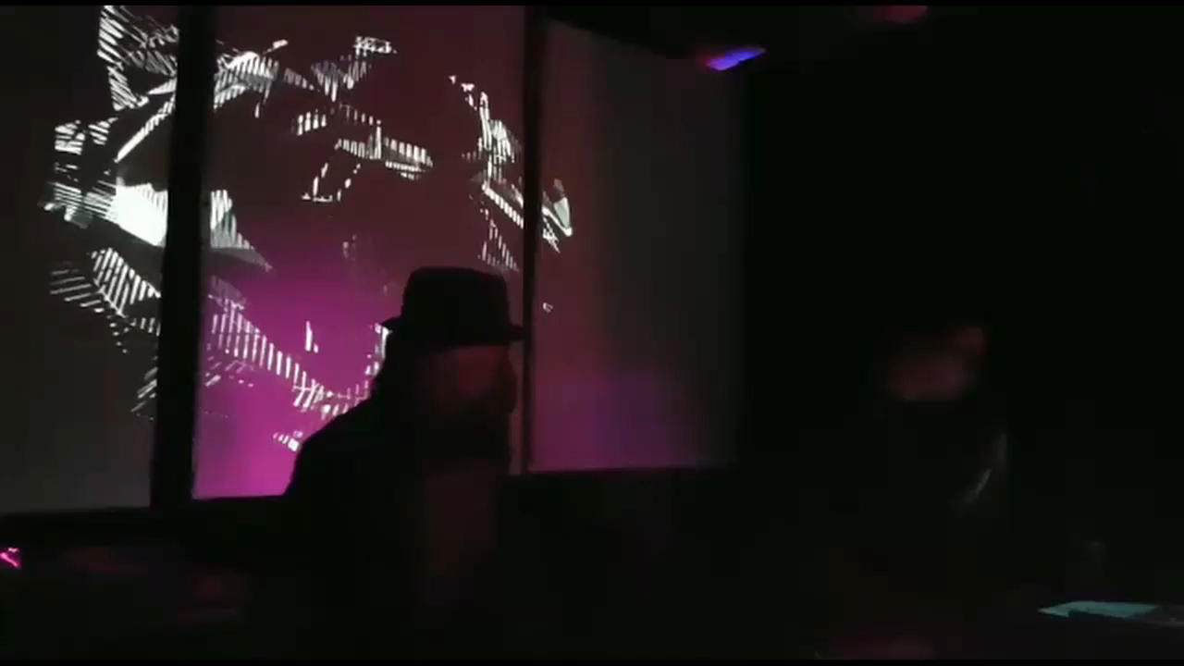

Slide 22
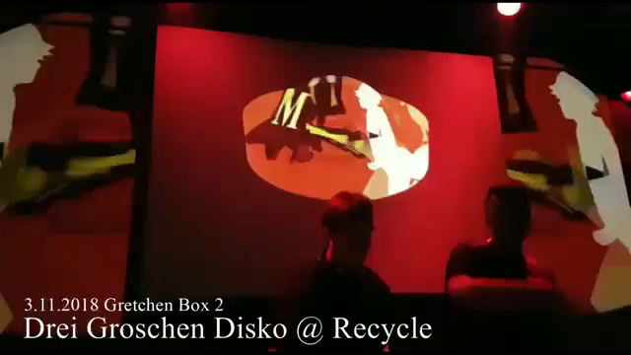

Slide 23
PoSh – Poll Share
Voting and Mediaplaybacksystem for the theatreproduction „Reset:Earth“ at Erlangen in coop with „Komplexbrigade“
Browserbased Votingsystem for Smartphones via NodeJS
Playback of Videofiles and Audioclips
Control of a Masterscore

Slide 24


Slide 25
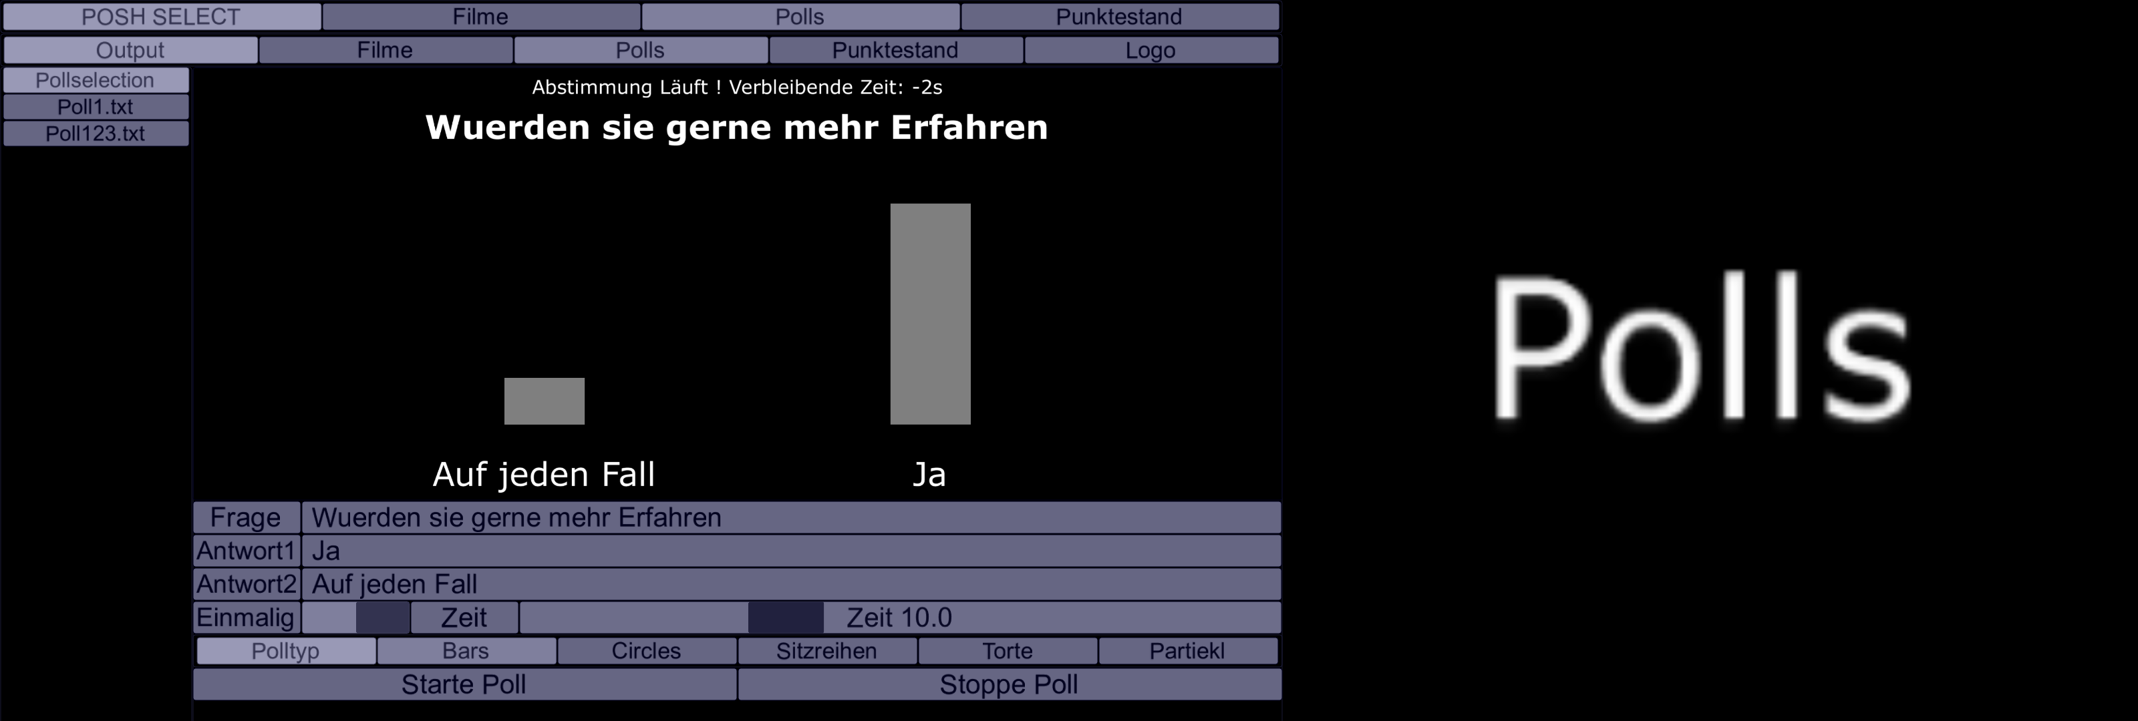

Slide 26


Slide 27
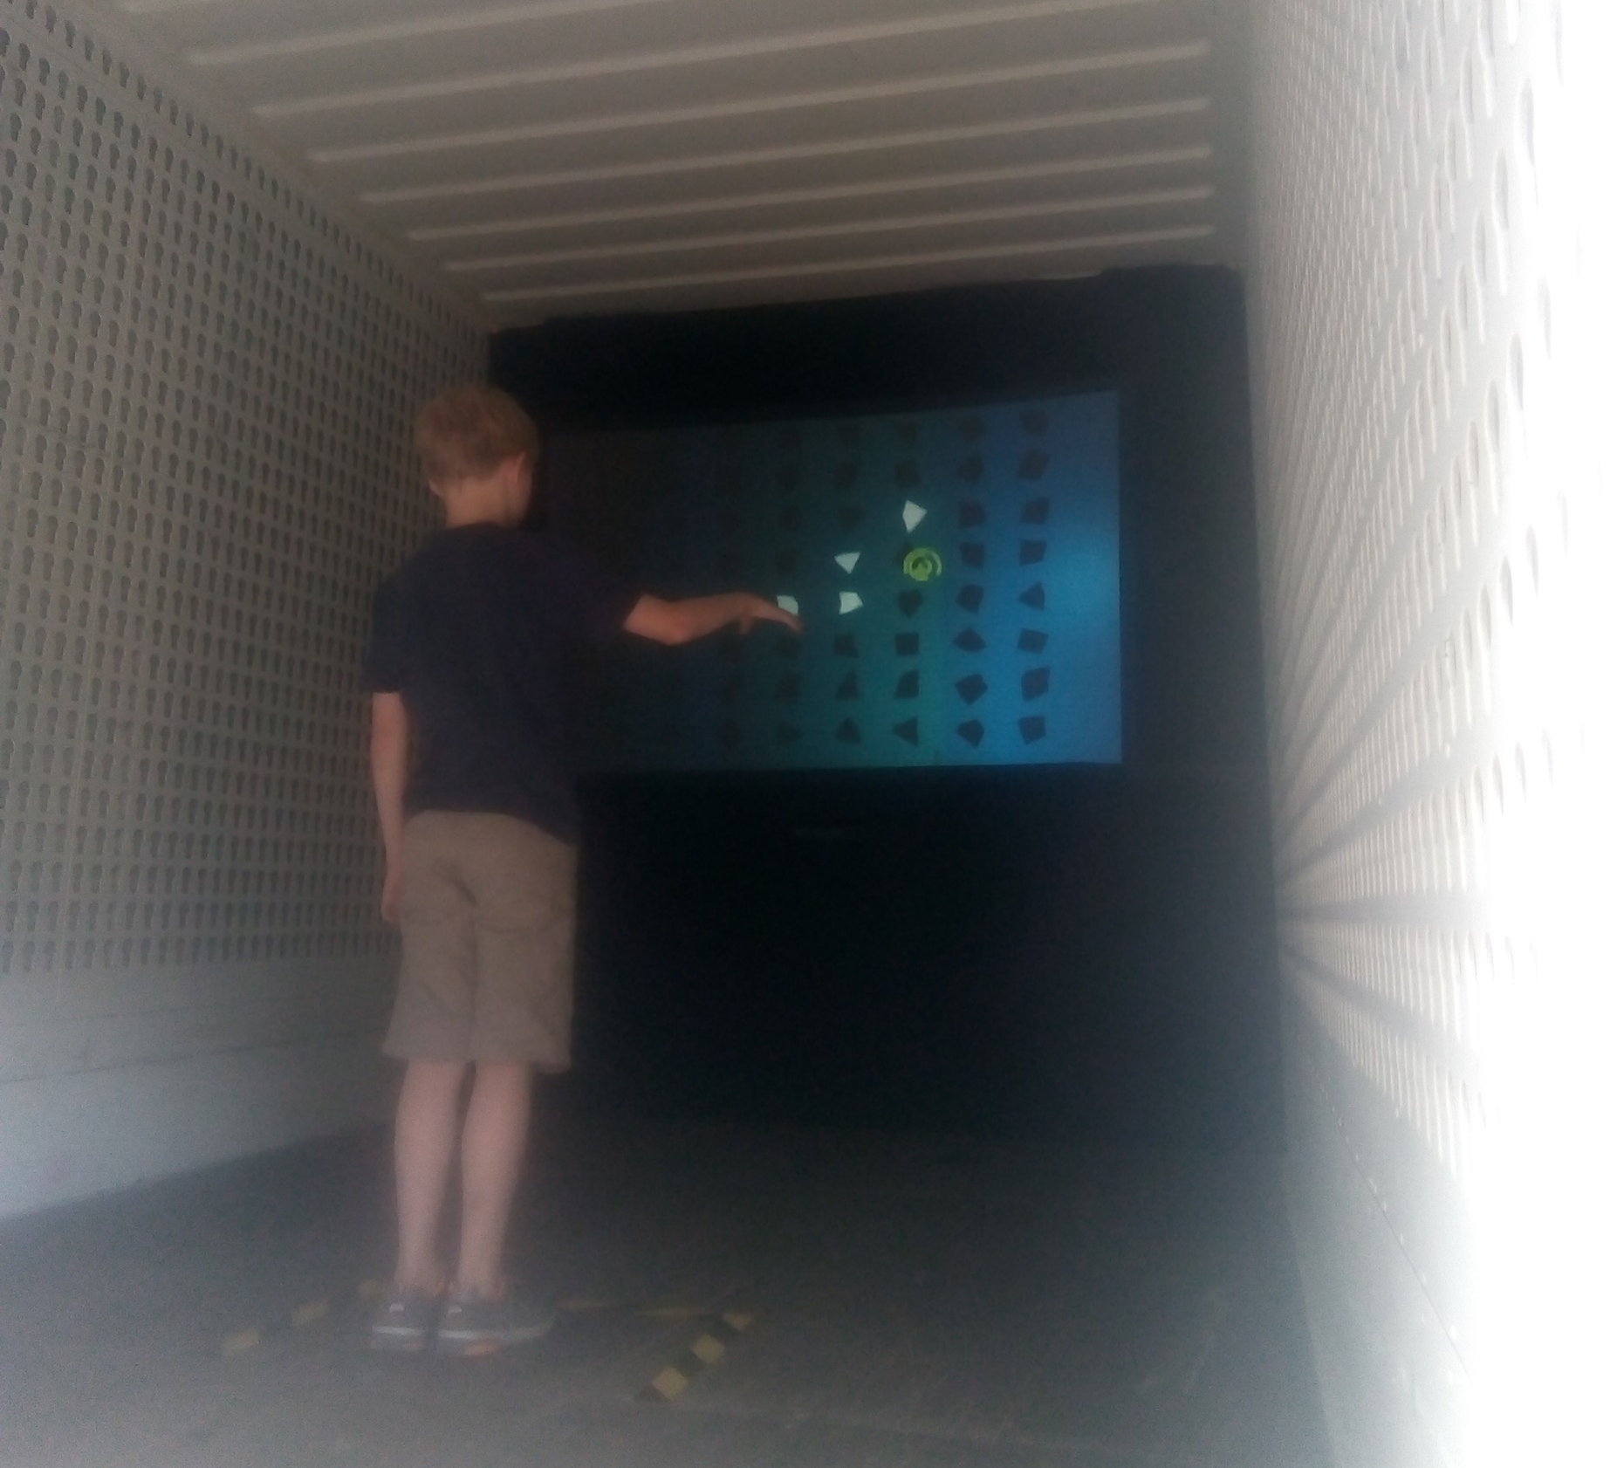
„Dive In“ – Working Title Mutrix
Interactive Installation for „Stadt für eine Nacht“-Festival
Controlled via Kinect
4 Channel Stepsequenzer
It was a disaster

Slide 28
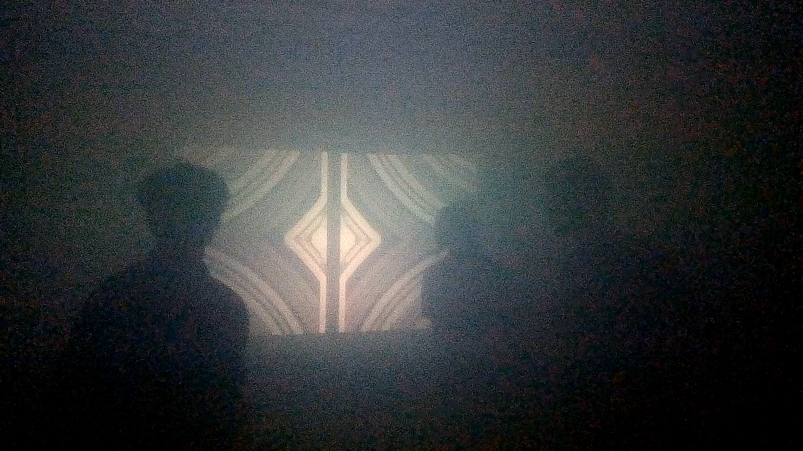

Slide 29
